Slide 1
Which Food Group Produces the Most CO2 Waste During Processing?
Katie Pocock
CMSE 201 - Section 004
12/5/2021

Slide 2
Background and Motivation
Greenhouse gases, huge problem
My personal impact, does changing my diet actually help?
Food Types not included in dataset are ignored, may have an impact

Slide 3
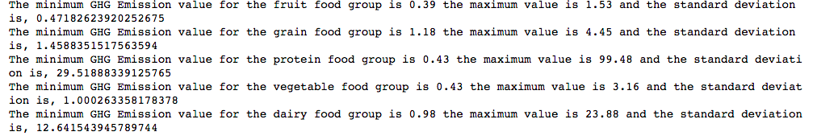
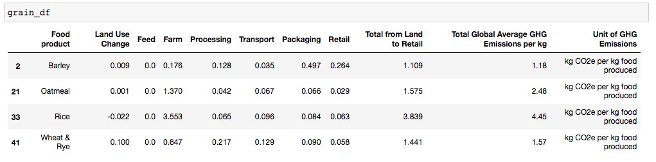
Methodology
Dropped data that I deemed unnecessary to answer my question
Used pandas to organize the data frame into new data frames based on the food group that it would fit into.
Found the maximums, minimums, mean, and standard deviation of each food group to better understand why the GHG emissions may be higher for specific food groups. Using math
Find which mean is the greatest, this answers our question

Slide 4
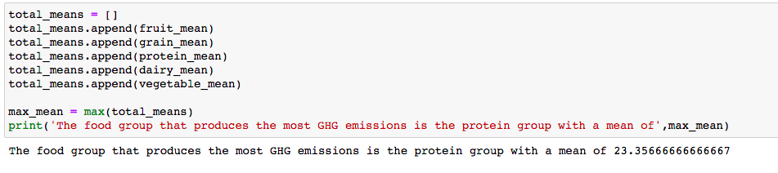
Answering My Question

Slide 5
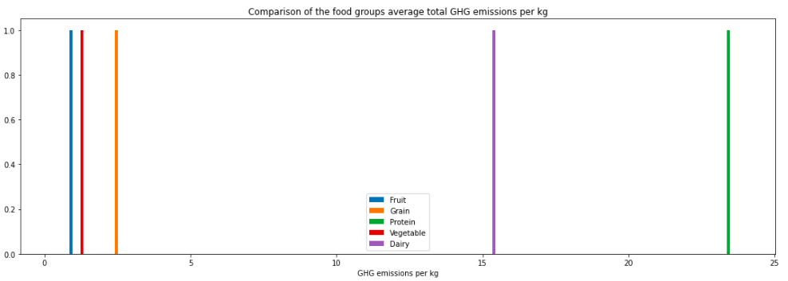
Results

Slide 6
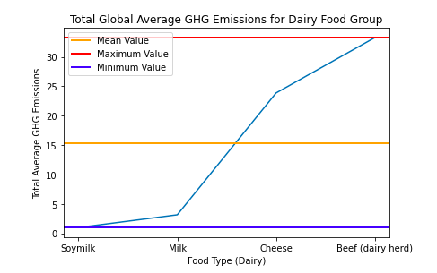
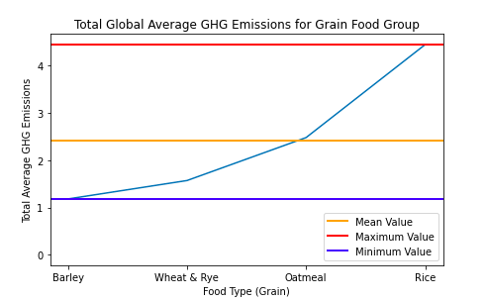
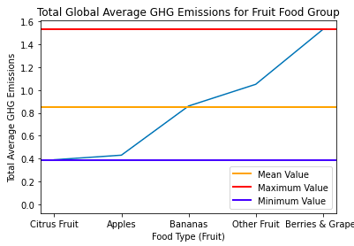
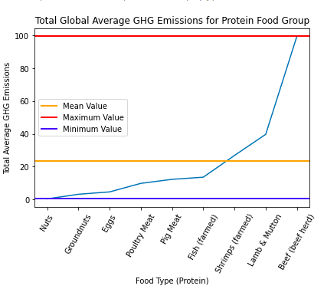
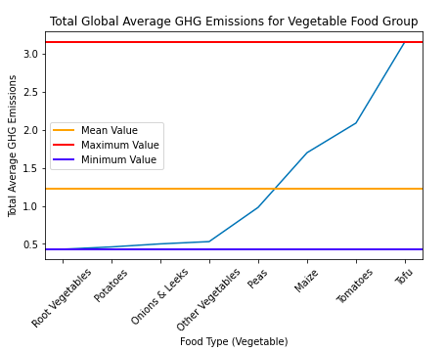

Slide 7
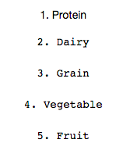
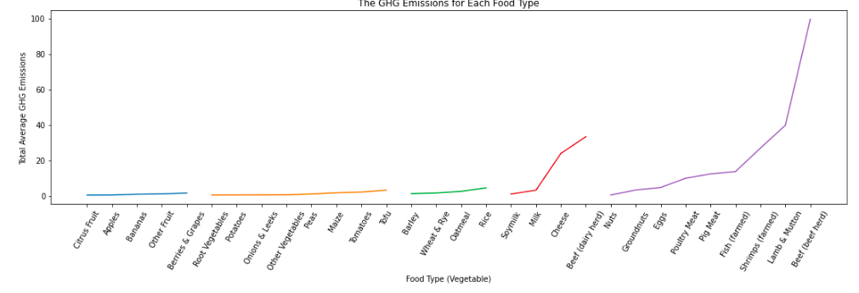
Conclusions
Limited Data
Where I would go from here

Slide 8
References
1. AmandaRoseKnudsen. “Foodemissions.” Kaggle, 20 Oct. 2021, https://www.kaggle.com/amandaroseknudsen/foodproductemissions.
2. EPA, Environmental Protection Agency, https://www.epa.gov/ghgemissions/overview-greenhouse-gases.
3. “Protein Foods.” MyPlate, https://www.myplate.gov/eat-healthy/protein-foods#:~:text=All%20foods%20made%20from%20seafood,of%20the%20Protein%20Foods%20Group.

